Slide 1
Welcome!
If you are attending the webinar on your computer, please add your name, title, and organization(s) to the chat box.
Bring your mouse to the lower part of the screen until a set of buttons appears. They may also be at the top of your screen.
Click “Show Conversation.”

Slide 2
Franklin County, Ohio Hazard Mitigation Plan – 2023 Update
Planning Team Kick-Off Meeting
November 18, 2022

Slide 3
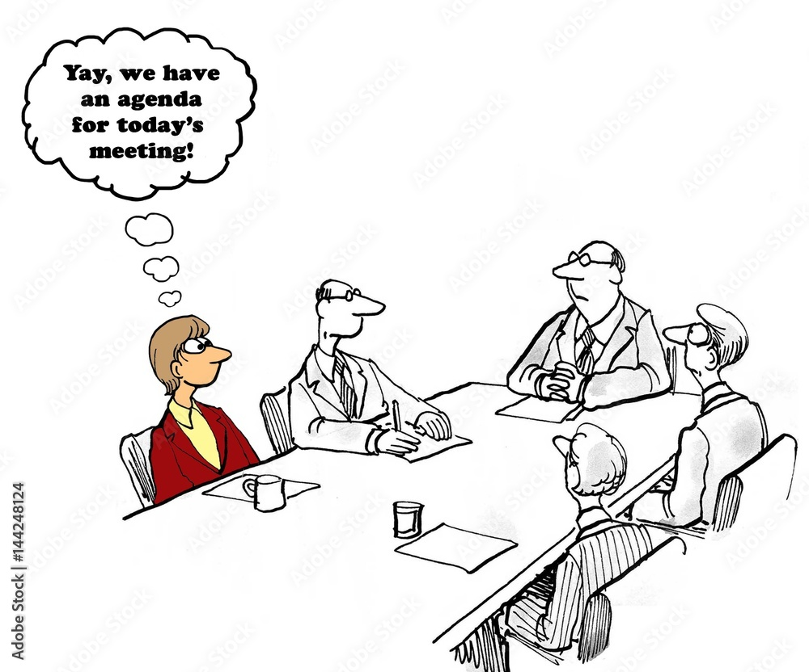
Agenda
Welcome
In-Kind Services Tracking
Benefits of Hazard Mitigation
Hazard Mitigation Planning Overview
Project Organization
Planning Team Responsibilities
Planning Process Overview and Municipal Worksheets
Schedule
Questions/Next Steps/Wrap Up

Slide 4
Introductions
If you haven’t done so, use the chat feature to tell us your…
Name
Job title
Jurisdiction you represent
Your department/ organization

Slide 5
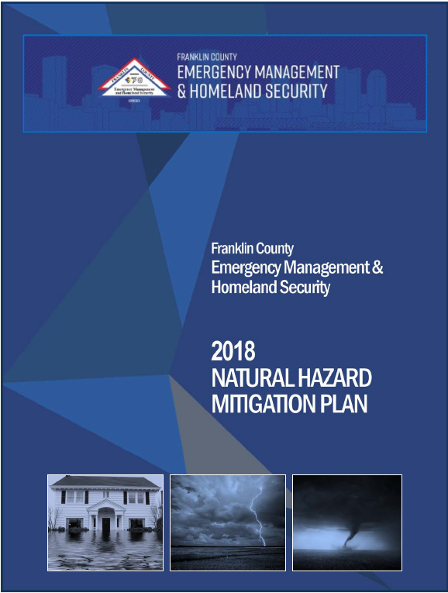
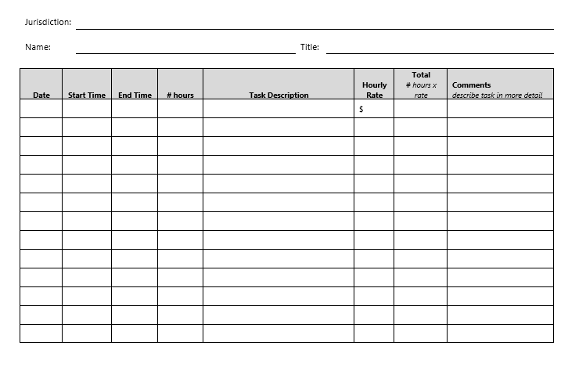
In-Kind Tracking

Slide 6
Hazard Mitigation Planning Overview
What is hazard mitigation?
Why update the plan?
What’s new?
What is the process?
Authorized by the Disaster Mitigation Act of 2000
Provides an overview of the impacts of natural hazards on communities
Provides a roadmap to reducing the impact of these hazards
Requires a FEMA-approved natural hazard mitigation plan to be eligible for Pre- and Post-Disaster Mitigation Funding
5-year updates required to maintain eligibility
Organize and Review
Risk Assessment
Public and Stakeholder Involvement
Capability & Mitigation Strategy
Assemble the Plan
Plan Maintenance
Plan Review and Adoption
Notes:
Let’s start with going over the HMP process and why we are updating the County’s HMP. During this process, we will be updating the entire plan to ensure:
We meet the new April 2023 FEMA guidelines and requirements – mitigation actions for every hazard of concern, future impacts on hazards from climate change, integrating the HMP into local plans and day-to-day operations, and looking at socially vulnerable populations and how hazards can impact them
Incorporate a clearer communication of risk – describe the hazards, identify community assets, look at what’s at risk, summarizing the vulnerability, and coming up with actions to reduce that risk and vulnerability
We want a strong connection between the risk assessment and the mitigation strategy
Integrating the HMP into county and municipal policies, procedures, and decision making
What does the process look like? It’s a 7-phase approach that builds towards an actionable plan that builds towards implementation and resilience
In The next few slides, we will go over the following -
What is hazard mitigation
Why update
What’s new
What is the process

Slide 7
Hazard Mitigation – What is it?
Prepare / Prevent
Mitigation
Response
Recovery
Mitigation is a sustained action taken to reduce or eliminate long-term risk to life and property from a hazard event
-or-
Any action taken to reduce future disaster losses
“provides the blueprint for reducing the potential losses identified in the risk assessment, based on existing authorities, policies, programs and resources, and local ability…” (CFR).
Notes:
It is part of the emergency management cycle – by mitigating hazards it helps communities prepare for or prevent an event from occurring and reducing or eliminate response and recovery measures.
Mitigation describes actions taken to help reduce or eliminate the long-term risks/damages cause by hazards
To help us achieve mitigation, we need to start with the Hazard Mitigation Plan. Having an HMP helps us -
Increase education and awareness on natural hazards and community vulnerabilities
Build partnerships with government, organizations, businesses and the public to reduce risk
Identify long-term strategies for risk reduction with input from stakeholders and the public
Identify cost-effective mitigation actions that focus resources on the greatest risks areas
Integrate planning efforts and risk reduction with other community planning efforts
Align risk reduction with other county or municipal objectives
Communicate priorities to potential funders
Access FEMA funds – by participating in and adopting the HMP, you will remain eligible for FEMA pre- and post-disaster mitigation funding (HMGP, FMA, BRIC, and PDM)

Slide 8
Why Update?
The mitigation plan update will:
Help the County prepare for and mitigate the effects of disasters
Continue to allow the County and participating partners to be eligible for pre- and post-disaster mitigation funding
Support CRS participation/rating of municipalities
Hazard | Losses (1950 – June 2022)
Extreme Cold/Freeze | $100,000 (property); $540,000 (crop)
Drought | --
Extreme Heat | --
Flash Flood | $1.5 million (property)
Flood | $170,000 (property)
Hail | $181.2 million (property)
Heavy Rain | --
Lightning | $21,000 (property)
Tornado | $58.1 million (property)
Winter Weather | $1.2 million (property)
Wind | $138+ million (property)
TOTAL | $380+ million (property); $540,000 (crop)
Source: NOAA-NCEI 2022
Notes:
Why are we updating?
FEMA requires that any state, county, or jurisdiction with an approved HMP must update it every 5-years
In order to apply for and be eligible for FEMA pre- and post-disaster grant funding
Things change – types of hazards, population, critical facilities and community lifelines, etc.
New FEMA guidance for 2023 –
Need to document the planning process and include records of meeting minutes, sign-in sheets, website postings, etc.
Participation – the Steering Committee and municipalities must actively participate – attend meetings, review sections, identify specific mitigation actions, and adopting the plan
Climate change must be discussed in each hazard profile and describe how climate change can affect the future occurrence of each hazard.
Socially vulnerable populations and underserved communities must be incorporated into the risk assessments and the impacts hazards can have on them
Implementation – we need to show how existing plans, policies, programs, codes, etc. support mitigation and how the HMP is integrated into each.

Slide 9
What is the process?
Organize the Resources
Risk Assessment
Public and Stakeholder Outreach
Capability and Mitigation Strategy
Assemble the Plan
Plan Maintenance
Plan Review and Adoption
Phase 1
Phase 2
Phase 3
Phase 4
Phase 5
Phase 6
Phase 7
Notes:
We will be using this 7-phase process to update the HMP. Today, we will be going over each of those phases and what we need from you to help us update.

Slide 10
Organize the Resources
Phase 1
Notes:
The first phase is organizing the resources. During this phase, we coordinate with the County to organize key components for updating the plan. This includes identifying Core Planning Team members and the Planning Team. We have kick-off meetings with each group and start coordinating with stakeholders and the public.
You all are part of the Planning Team/Planning Partnership and we will go over what that means next.

Slide 11
Project Organization
Core Planning Team
Planning Team
County EM&HS
County Floodplain Manager
Ohio State University
City of Columbus
City of Dublin
City of Grove City
Mid-Ohio Regional Planning Commission
American Electric Ohio
Columbus NAACP
Bexley City
Canal Winchester City
Columbus City
Dublin City
Gahanna City
Grandview Heights City
Grove City
Groveport City
Hilliard City
New Albany City
Reynoldsburg City
Upper Arlington City
Westerville City
Brice Village
Harrisburg Village
Lockbourne Village
Marble Cliff Village
Minerva Park Village
Obetz Village
Riverlea Village
Urbancrest Village
Valleyview Village
Blendon Twp
Brown Twp
Clinton Twp
Franklin Twp
Hamilton Twp
Jackson Twp
Jefferson Twp
Madison Twp
Mifflin Twp
Norwich Twp
Perry Twp
Plain Twp
Pleasant Twp
Prairie Twp
Sharon Twp
Turo Twp
Washington Twp
Steering Committee
Franklin County EM&HS
Tetra Tech
Stakeholders
Ohio Emergency Management Agency (OEMA)
Emergency managers
Economic development
Planning
Floodplain administration
Public Works/Highways
Neighboring communities
Natural and cultural resources
Organizations that provide support to underserved communities and socially vulnerable populations
Notes:
This slide shows us the different agencies, departments, and municipalities that will be involved during the update.
All of you are part of the Planning Team and we will go over what that means in the next slide.
The Core Planning Team is responsible for providing guidance and leadership throughout the planning process. They will actively contribute, review and provide feedback on plan sections, update the plans’ goals and objectives, finalize the list of hazards of concern, and identify mitigation actions.
Stakeholders must be engaged throughout the planning process. At a minimum, this group should include neighboring counties, local and regional agencies involved in hazard mitigation activities, and agencies that have the authority to regulate development, as well as businesses, academia, and other private and nonprofit organizations. We will put together a draft list of stakeholders and ask for your input.
Next, we have Ohio Emergency Management Agency – they will provide the County guidance throughout the HMP update and will review/approve the plan before it is submitted to FEMA.
Lastly, we have the Steering Committee which is made up of Franklin County Emergency Management and Tetra Tech. This is a small group that will meet frequently to ensure the project stays on schedule and that we meet all State and FEMA requirements.

Slide 12
Planning Partnership Roles and Responsibilities
As the municipal representative for your community, you need to actively participate throughout the process in order to be included in the plan. This includes:
Coordinate and facilitate local efforts
Attend meetings
Provide information and feedback (e.g., complete municipal worksheets)
Involve the public and community stakeholders in the planning process
Identify mitigation actions for your community
Adopt the plan
Implement the plan and monitor its progress
All participation will be documented in the HMP
Notes:
All of you on this call today will be representing your municipality/organization throughout the planning process. FEMA requires everyone who will be adopting the HMP to actively participate. This includes attending meetings, providing requested information, involving the public and stakeholders, developing mitigation projects, and adopting and implementing this plan.
We will be keeping track of participation as well. But please use the in-kind tracker to keep track of your time and what you worked on (including meetings, phone calls, etc.)

Slide 13
Risk Assessment
Phase 2
Notes:
Next Phase – Risk Assessment
Mitigation plans identify the natural hazards and risks that can impact a community based on historical experience, estimate the potential frequency and magnitude of disasters, and assess potential losses to life and property. The risk assessment process provides a factual basis for the activities proposed in the mitigation strategy.
We will be going over how we are updating the risk assessment and what we will need from you to do so

Slide 14
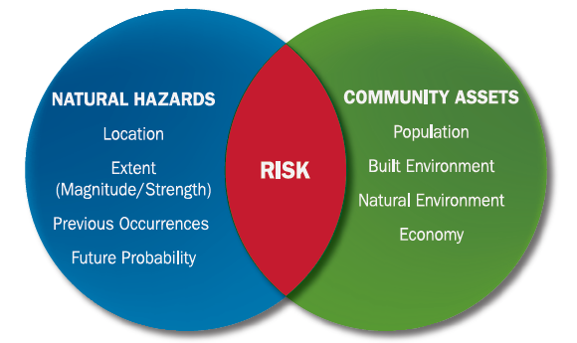
Update Risk Assessment
Update assets
Examine previous impacts
Analyze risks
Review with Core Planning Team and Planning Team
Risk assessment meeting
Notes:
To complete the risk assessment, we need to:
Review and update the hazards of concern
Update assets – critical facilities and community lifelines
Look at the impacts of each hazard since the last HMP
Analyze the risk to each asset
Review the findings with each of you during the risk assessment meeting

Slide 15
Hazards of Concern (2018 HMP)
Dam/Levee Failure
Drought
Earthquake
Extreme Heat
Flooding
Invasive Species
Karst/Sinkhole
Severe Summer Weather
Severe Winter Weather
Tornadoes

Slide 16
Hazards of Concern (2023 HMP)
Dam/Levee Failure
Disease Outbreak
Drought
Earthquake
Extreme Temperature (heat/cold)
Flooding (inland, flash, urban/stormwater, ice jam)
Geologic Hazards (sinkholes, erosion)
Invasive Species
Severe Summer Weather
Severe Winter Weather
Tornadoes
Notes:
Hazards of Concern
Before we can start looking at the type of risk from each hazard, we need to know what we are including this time around. Here is the list of hazards from the 2018 HMP. To help us streamline the hazards, this is our suggested list.
Anything in blue is our suggestions for modifications/additions.
We will be sending out a survey for you to provide input on this list and then have a meeting to finalize it.

Slide 17
EXERCISE – Identifying Hazards of Concern
Looking at the hazards included in the 2018 plan…
Have additional hazards impacted the County since 2018?
Have hazard been mitigated and no longer cause damage?
Should hazards be regrouped to align with the 2019 State HMP?
Should additional hazards be included?
How have hazards affected the county? Where are your problem areas?
Quick survey!
We will send around a quick online survey to get your input on the hazards of concern for the 2023 HMP – Stay tuned!
Notes:
Looking at the hazards from the last plan, are there any we should remove? Add? When you have a chance, please complete the survey to answer a few of these questions. Once we have an understanding of what everyone thinks should be included, we will run the list by the SC for their approval.

Slide 18
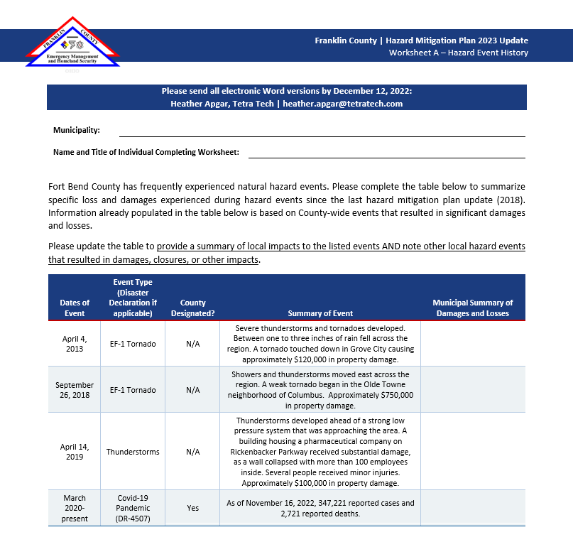
Worksheet A – Hazard Event History
Notes:
To help us get an understanding of the hazards that affect each of you, we will be using Worksheet A to collect event information from each of you.
The first table on the worksheet lists just the FEMA declarations that Fort Bend was included in. If you had any specific damages (property damage, road closures, etc.), please add that to the last column of the table. If you did not have any damages, just write not damages or N/A.
The second table is where you can document any events that were not listed in the first table. So maybe a strong thunderstorm came through and knocked down trees, caused power outages, and you had police and public works overtime to clear the debris and direct traffic.
We don’t need a lot of details when summarizing the damages. Keep it short and to the point.

Slide 19
Critical Facilities and Community Lifelines
Review 2018 critical facility inventory to ensure complete
Crosswalk and identify lifelines
Critical Facilities are those facilities considered critical to the health and welfare of the population and that are especially important following a hazard. As defined for this HMP, critical facilities include essential facilities, transportation systems, lifeline utility systems, high-potential loss facilities, and hazardous material facilities.
Essential facilities are a subset of critical facilities that include those facilities that are important to ensure a full recovery following the occurrence of a hazard event. For the County risk assessment, this category was defined to include police, fire, EMS, schools/colleges, shelters, senior facilities, and medical facilities.
Lifelines provide indispensable service that enables the continuous operation of critical business and government functions, and is critical to human health and safety, or economic security
Notes:
Do we expand critical facility definition to include lifelines for this planning effort? What does that mean and what is the benefit?
With the new BRIC program, we also want to look at lifelines and identify which critical facilities are also lifelines.
What are lifelines? Lifelines enable critical government and business functions to operate continuously and are essential to human health and safety or economic security. They are the most fundamental services in a community that, when stabilized, enable all other aspects of a community to function.
While lifelines were developed to support response planning and operations, the concept can be applied across the entire preparedness cycle. Efforts to protect lifelines, prevent and mitigate potential impacts to them, and building back stronger and smarter during recovery will drive overall resilience in the County!
This illustrates the relationship of mitigation planning to response, recovery, and ultimate resiliency. Most efficient to work with Marty and John to expand the definition and inventory and provide to SC for input and confirmation. Tetra Tech will provide that list and request input from all of you.

Slide 20
Critical Facilities and Community Lifelines
Emergency Response | Public Services and Utilities | Private/ Commercial | Transportation | Other
Hospitals/Medical Clinics Communications/Emergency Operations Centers Other Direction and Control Operations Centers Essential Government Buildings Fire Departments/EMS Services Law Enforcement/Sheriff, Police Jails/Correction Centers Emergency Shelters Disaster Recovery Centers/Disaster Field Offices Public Health Departments | Emergency Alert System Stations and Towers: Radio, Television and Cable Other Radio and Television Stations and Towers Government Communications Towers and Repeaters Telephone System Distribution Points and Towers: Land Line, Cellular, Microwave Sewage Treatment and Plants Potable Water Distribution Systems, Treatment Plants, and Lift Stations Electrical Power Generating Plants and Electrical Substations Major Electrical Distribution Systems/Routes Essential Public Service Offices | Private Potable Water Treatment and Distribution Systems Private Sewage Treatment and Waste Systems Commercial Distribution Centers Building/Construction Materials Potable Water and Ice Suppliers Food Retailers Power Generators Suppliers of Fuels (Gasoline, Diesel, Propane, Natural Gas, etc.) Suppliers of Light Equipment (Chain Saws, Shovels, Barricades, etc.) Suppliers of Heavy Equipment (Bulldozers, Forklifts, etc.) Medical Supply Companies Food Processing Plants Restaurants/Cafeterias Community Centers/Auditoriums Major Fuel Pipelines and Terminals/Fuel Storage and Tank Farms | Airports/Heliports Response Operations Staging Areas Critical Transportation Routes High Risk Intersections/Critical Links/Bridges Railroad Stations | Churches/Synagogues Fellowship and Recreation Halls Colleges/Universities Public and Private Schools Motels/Hotels Nursing/Convalescent/Group Homes Animal Care/Animal Shelters Hazardous Materials Facilities Flood Control Stations and Devices
Notes:
These are all the facilities included in the HMP last time.

Slide 21
Critical Facilities and Community Lifelines
What additional facilities and lifelines should we add? Types to consider:
Critical food establishments – food pantries, grocery stores, senior nutrition
COVID-19 locations – testing and vaccination sites
Others?
Notes:
In the next few weeks, we will be sending around a survey link to review, update, and add to this list. So start thinking about what you might want to add. The County had a very thorough list last time and it covers a majority of facilities/lifelines typically included in the HMP. But think about what places have been essential during the pandemic and recent hazard events? Should those be included in the plan this time?

Slide 22
Public and Stakeholder Outreach
Phase 3

Slide 23
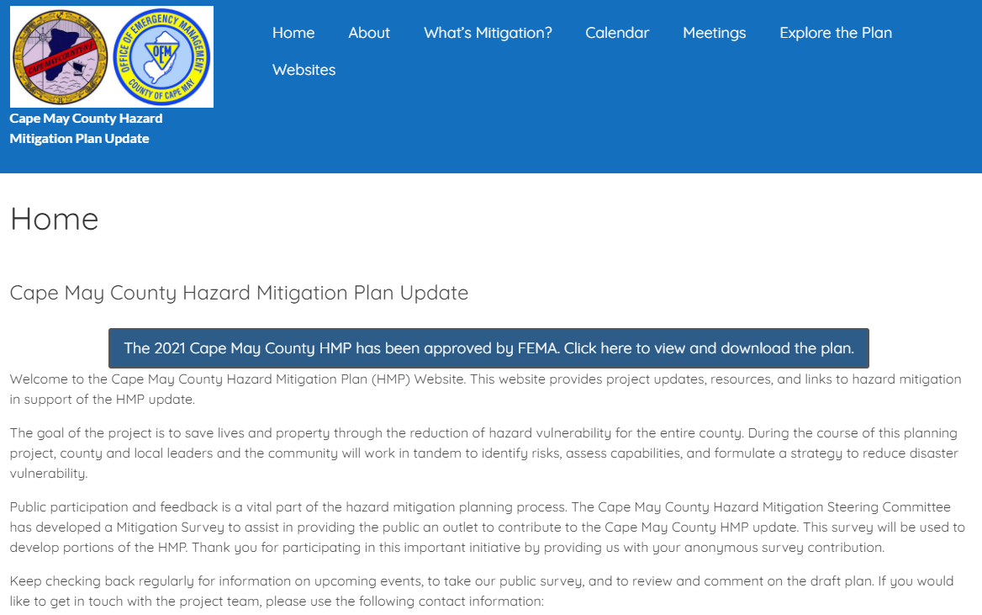
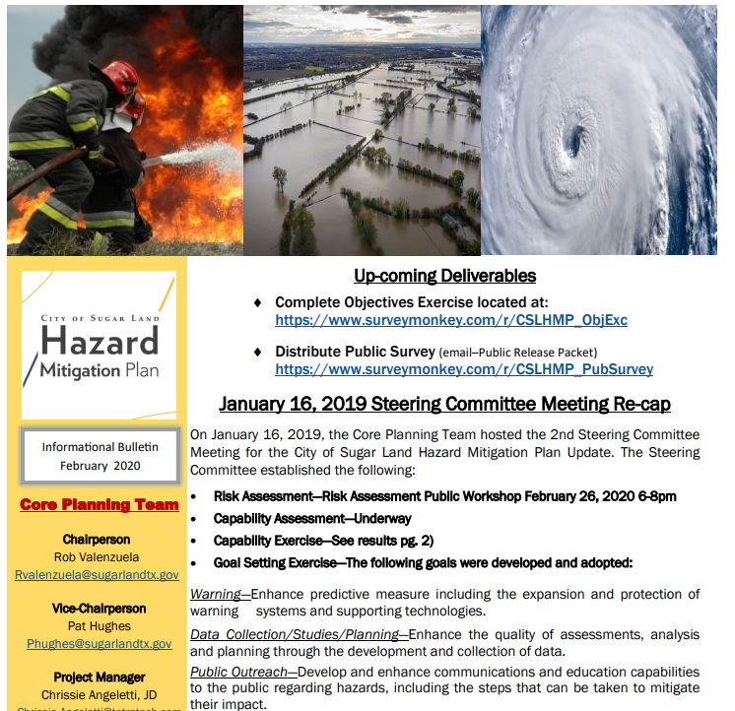
Public and Stakeholder Outreach
Social Media Posts
Press Release
HMP website – in the works…stay tuned!
Planning Team meetings open to the public and stakeholders
Stakeholder Survey
Public Survey
Neighboring County Outreach
Notified of planning process
Survey

Slide 24
Capability and Mitigation Strategies
Phase 4

Slide 25
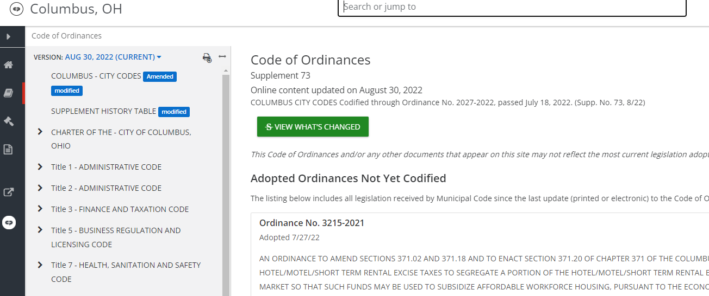
Update the Capability Assessment
Capabilities
Planning and Regulatory Capability
Administrative and Technical Capability
Financial Capability
Education and Outreach
Notes:
A capability assessment helps us understand the various programs, plans, codes, and staff you have that can currently reduce losses related to disasters or could be used to reduce losses in the future.
The HMP must include a description of your existing codes/programs/plans/resources available to accomplish hazard mitigation – we will look at your existing plans, reports, and information to get an understanding and then help you identify areas where you can improve your capabilities and how you can integrate hazard mitigation into those (via mitigation actions).
To collect this information, we will be using a worksheet. We have already pre-populated this for you using info from the last HMP and from looking on your municipal website. Please review and update accordingly. Anything blank needs to be filled in by you.

Slide 26
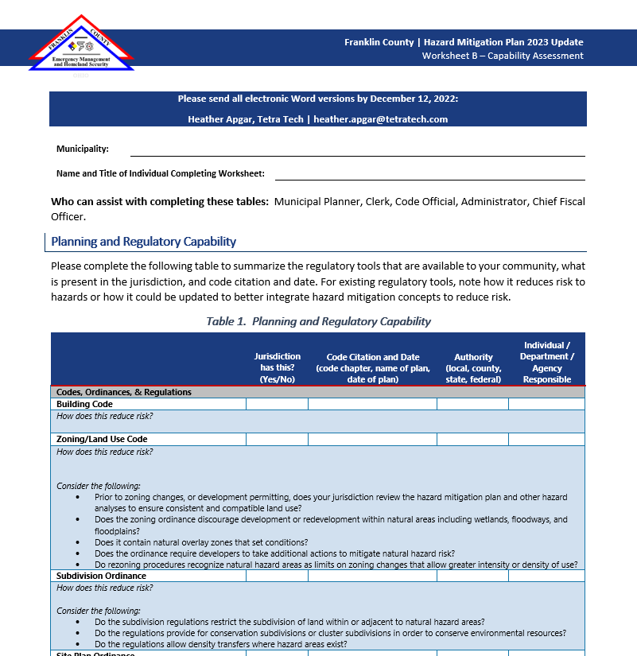
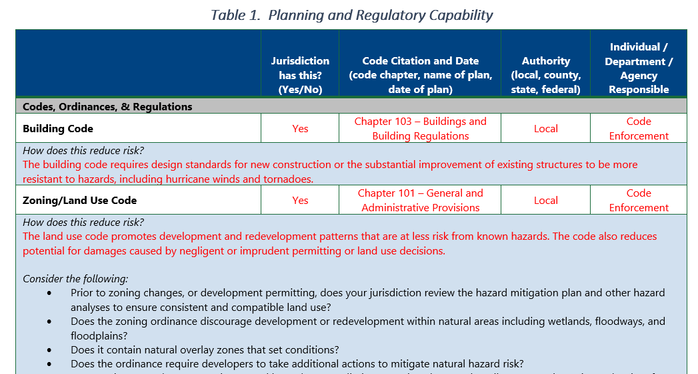
Worksheet B – Capability Assessment
Notes:
We will be using Worksheet B to help us update the capability assessment portion of the HMP
These tables will be presented in each of your individual chapters of the HMP.
For the Worksheet, we pre-populated each of them using information your last HMP and information we could easily gather from your municipal websites.
Review the information in each of the tables on the worksheets and update accordingly.
FEMA and OH EMA will be looking at these to see how each of you are addressing hazard mitigation in your day-to-day operations, what programs you have in place, etc. and what opportunities you each have in integrating hazard mitigation in the future.

Slide 27
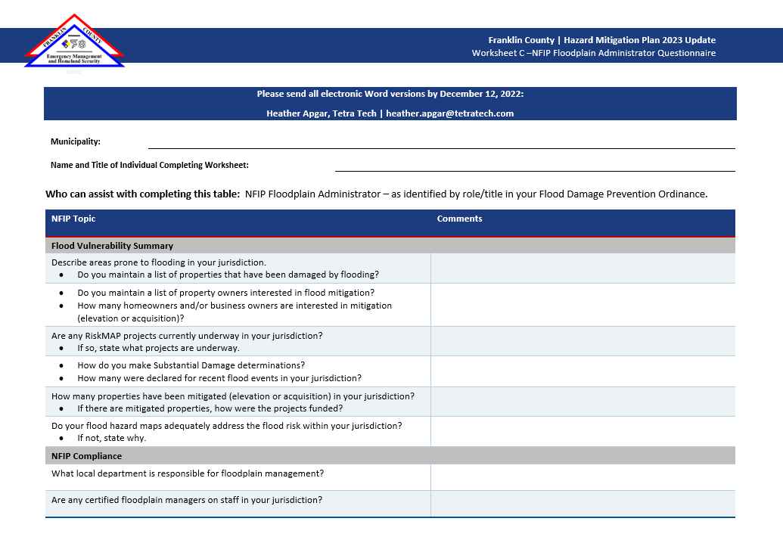
Worksheet C – NFIP FPA Questionnaire
Notes:
FEMA requires that we address each jurisdiction’s participation in the NFIP and how they comply with the program. To do this, we will be using Worksheet C
The best person to fill this out is your floodplain administrator, municipal engineer, or whoever has the most knowledge about flooding and the NFIP program
Questions include:
Date of the latest flood damage prevention ordinance
How does the municipality determine substantially damage properties
Who is responsible for floodplain management in the municipality
If you participate in the Community Rating System (CRS) program, you must describe the activities you are doing related to this program.

Slide 28
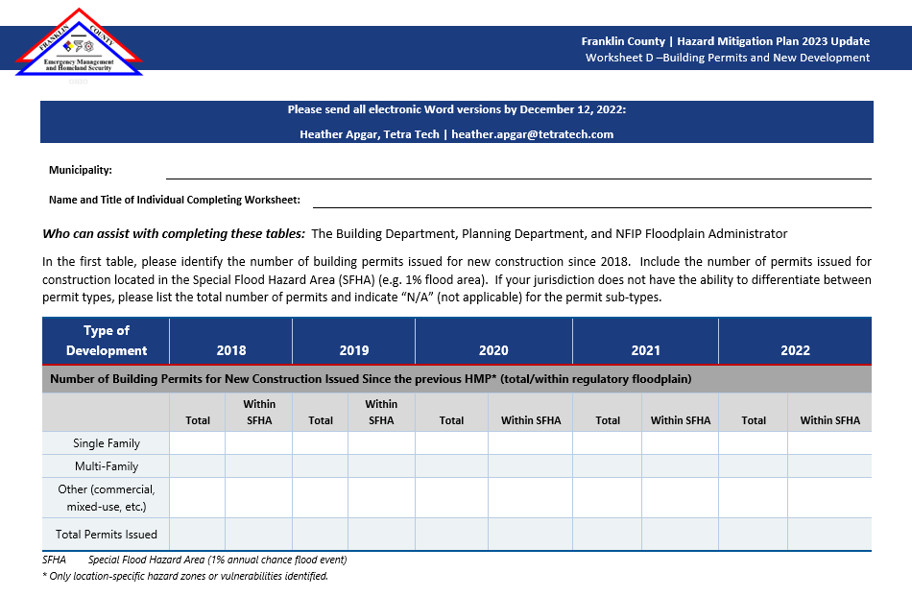
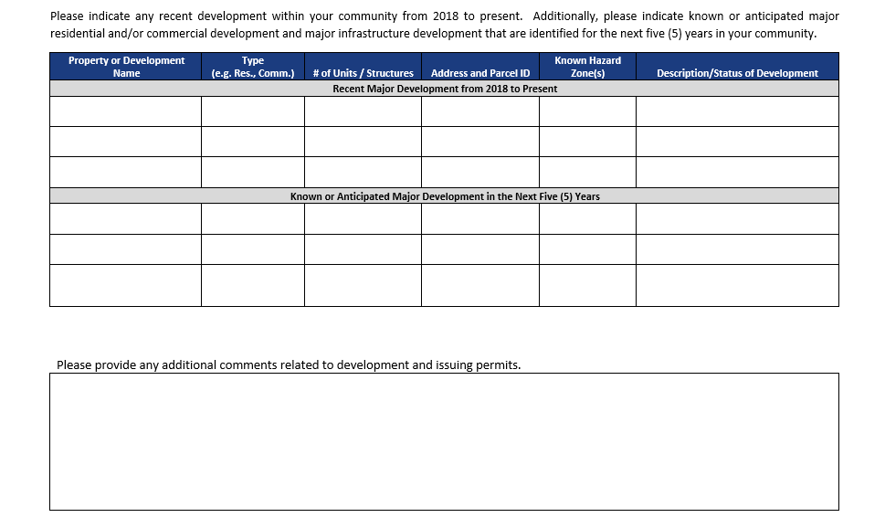
Worksheet D – Building Permits and New Development
Notes:
We also need to document how much development has occurred (or will occur) during the 5-year period of this HMP – we will use worksheet D for this
FEMA requires that we show where the new development is occurring and whether or not it is occurring in hazard areas (e.g., floodplain) and also how development and land use has changed since the last plan
Collecting this information will help us meeting this requirement

Slide 29
Mitigation Strategy
Goals
Actions
Action Plan
Goals
What outcomes do you want to achieve?
Actions
What specific actions will be taken to reduce risk from hazards?
Action Plan
How will the actions be prioritized and implemented?

Slide 30
Update the Mitigation Strategy
Determine the status of mitigation actions
Identify new mitigation actions/projects
Focus on specific, implementable, and achievable actions!
Look at your list of critical facilities and lifelines – what do they need to be operational during a disaster?
One mitigation action for every hazard of concern!
Conduct Mitigation Strategy Workshop – date TBD
Notes:
The next steps in the process if updating the mitigation strategy. To do so, we will be reviewing/updating the goals (Steering Committee will be working on this), providing a status of the mitigation actions identified in the 2018 HMP, and identifying new actions to include in the 2023 HMP.
Each municipality will need to provide a status of the mitigation actions. This is where Worksheet E comes in.

Slide 31
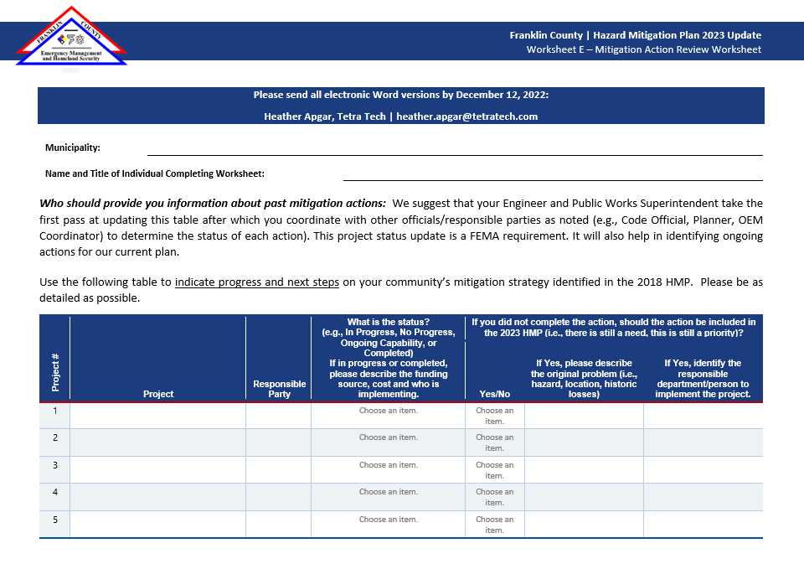
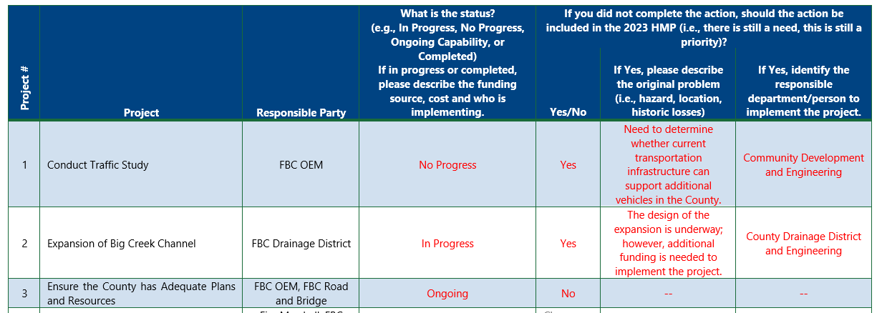
Worksheet E – Action Review

Slide 32
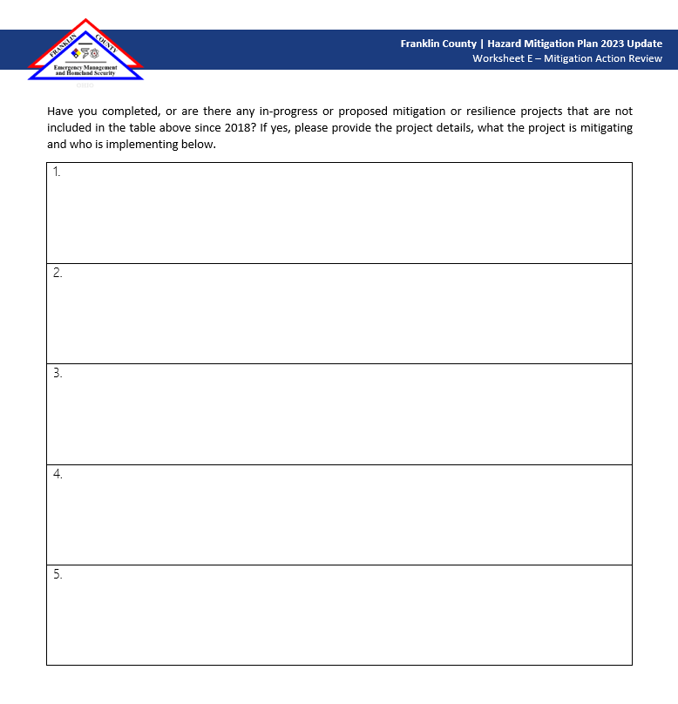

Slide 33
Assemble the Plan & Plan Maintenance
Phase 5 & 6

Slide 34
Update Other Sections of the Plan
Volume I | Volume II | Appendices
Section 1 – Introduction | Section 8 – Planning Partnership | A – Plan Adoption
Section 2 – Planning Process | Section 9 – Jurisdictional Annexes Each participating jurisdiction will have their own chapter | B – Participation Matrix
Section 3 – County Profile |  | C – Meeting Documentation
Section 4 – Risk Assessment |  | D – Outreach
Section 5 – Capability Assessment |  | E – Supplemental Data
Section 6 – Mitigation Strategy |  | F – Critical Facilities
Section 7 – Plan Maintenance |  | G – Plan Review Tools
 |  | H – Mitigation Strategy Tools
 |  | I – Linkage Procedures

Slide 35
Plan Review and Adoption
Phase 7

Slide 36
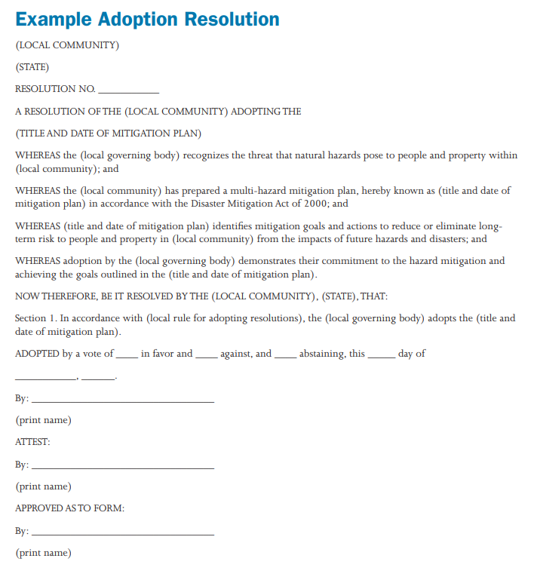
Plan Adoption & Implementation
Implementing your HMP…
Integration –
Link to local planning efforts
Hazard mitigation principles into your comprehensive or master plan
Interagency coordination
Projects/Actions –
Explore funding options to complete projects
Develop grant applications
Implement the projects
Notes:
Adopt the plan
Franklin County and at least one participating municipality need to adopt the HMP in order for it be considered ‘approved’
You can adopt the plan BEFORE it receives APA from FEMA.
Adoption deadline – TBD
Implement the plan
Regular Planning Team meetings
Continued public outreach
Stakeholder meetings
Implement mitigation actions and projects
Integrate actions where appropriate

Slide 37
Next Steps/Schedule
Planning Process
Core Planning Team Kick-Off – November 7th
Planning Team Kick-Off – TODAY!
Worksheets due December 12th!
Update Risk Assessment
Data collection is underway; confirm building and critical facility inventory
Confirm hazards of concern; once confirmed, begin vulnerability assessment for each – we will send a survey out to everyone to collect input on hazards
Discuss risk assessment results – date TBD
Public and Stakeholder Outreach
Ongoing throughout the planning process
Capability Assessment
Currently working on reviewing plans, studies, codes, and ordinances
Mitigation Strategy
Begin working with the municipalities after the Planning Partnership kick-off
Finalize goals during Core Planning Team meeting – week of November 27th (date TBD)
Mitigation Strategy Workshop with FEMA and State – week of January 15th (date TBD)
Plan Maintenance
Utilizing the BATool to review/update actions from 2023 HMP
Finalize plan maintenance procedures in February
Develop Plan
Draft Plan to Core Planning Team in April/May 2023
Draft to Ohio EMA – June
Draft to FEMA – August
Adoption – September/October

Slide 38
Questions?
Questions

Slide 39
Franklin County Project Contact
Connor Robb, Emergency Management Specialist (614) 724-0805 | connor.robb@franklincountyohio.gov
Tetra Tech Project Contacts
Doug McIlvain, Project Manager (513) 333-3662 | douglas.mcilvain@tetratech.com | Heather Apgar, Lead Planner (973) 630-8046 | heather.apgar@tetratech.com
Thank You!

